Slide 1
Near-Data Processing in Database Systems on Native Computational Storage under HTAP Workloads
VLDB 2022
Tobias Vinçon*, Christian Knödler*, Leonardo Solis-Vasquez#, Arthur Bernhardt*, Sajjad Tamimi#, Lukas Weber#, Florian Stock#, Andreas Koch#, Ilia Petrov*
#Embedded Systems and Applications Group, *Data Management Lab
#Technische Universität Darmstadt, *Reutlingen University

Slide 2
1 Background
2 Problem
3 Solution
4 Evaluation

Slide 3
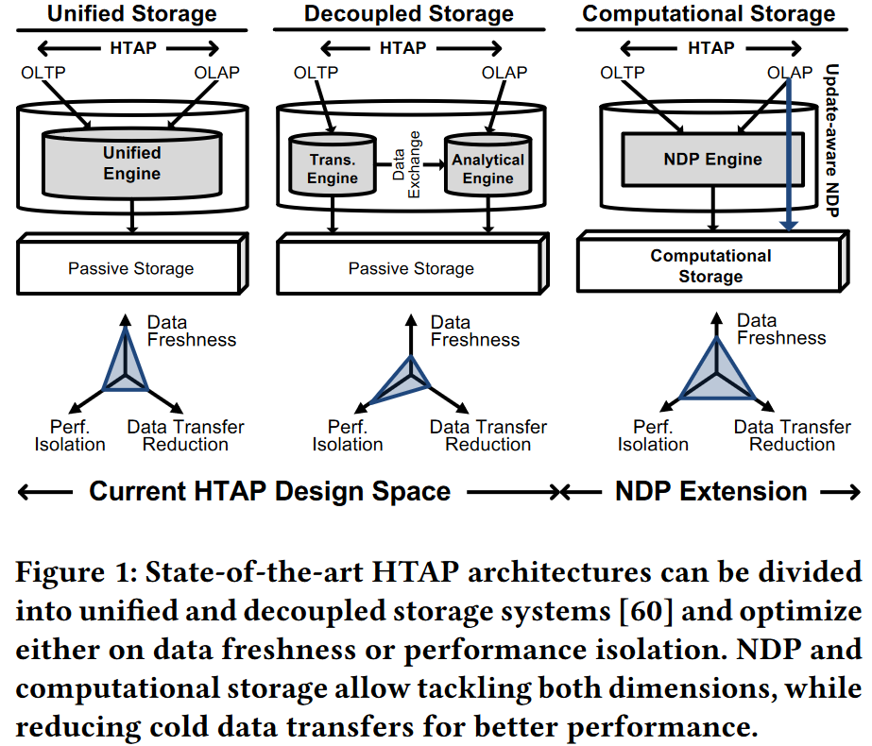
1 Background
Hybrid Transactional and Analytical Processing (HTAP) systems combines OLTP and OLAP
OLTP (online transaction process)
frequent and low-latency update transactions
operating on a small but hot portion of the entire data.
OLAP (online analytical process)
long-running analytical queries
with complex algorithms, operate on the cold data from the storage as well as the freshest updates from the OLTP workload.
Two types of HTAP architectures^{[1]}：
Unified storage：HyPer 、Caldera、DB2 BLU、SAP HANA
Execute the OLTP and OLAP operations on the same dataset
Based on snapshotting and multi-versioning techniques
Optimal for analytical processing on latest data
Decoupled storage：BatchDB、SQL Server、Oracle Dual Format
Separate the OLTP and the OLAP sub-system
Trade higher OLAP response times, data freshness, selective access, workload adaptability, for higher OLTP throughput
[1] Aunn Raza, Periklis Chrysogelos, Angelos Christos Anadiotis, and Anastasia Ailamaki. 2020. Adaptive HTAP through Elastic Resource Scheduling. In Proc. SIGMOD (Portland, OR, USA) (SIGMOD 20). 2043–2054.

Slide 4
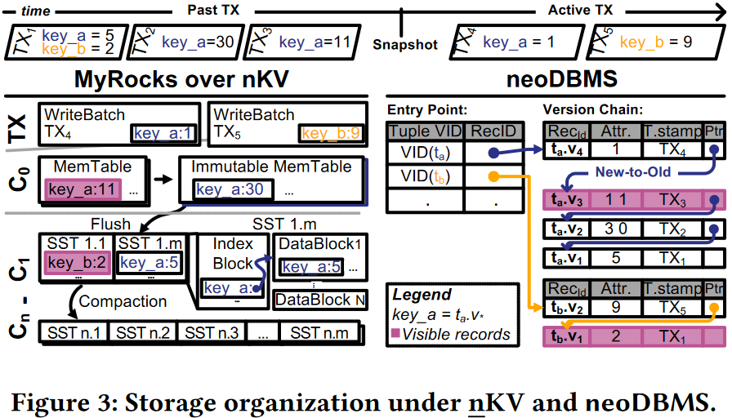
1 Background
This paper focuses on two systems: LSM-tree KV-Stores and multi-version DBMS.
nKV^{[2]}:
KV-store based on RocksDB;
Single-versioned, Copy-onWrite system, Repeatable Read as the highest isolation level;
Each active transaction is assigned a separate write batch that contains transaction-local modifications before commit;
neoDBMS^{[3]}：
Stores all updates as physically materialized version records identified by RecordID (<PageNr,SlotNr>);
Single-linked version chain in New-to-Old manner;
All version records in a chain have the same VID;
VID_{Map} marks the entry-point of a chain;
[2] Vinçon T, Bernhardt A, Petrov I, et al. nKV: near-data processing with KV-stores on native computational storage[C]//Proceedings of the 16th International Workshop on Data Management on New Hardware. 2020: 1-11.
[3] Bernhardt A, Tamimi S, Stock F, et al. neodb: In-situ snapshots for multi-version dbms on native computational storage[C]//Proc. ICDE. 2022.

Slide 5
2 Problem
HTAP extends the problem space of database architectures
Problem space
Data Freshness: Analytical portion of the HTAP should have the most recent data version from OLTP workload
Data Consistency: Transactional and analytical queries should have a consistent view on the data
Data Transfers: Data transfers from storage tier to host processing units account for large part of the overall performance
Performance Isolation: Interference between OLTP and OLAP workload must be prevented
Memory Pollution: Analytical queries fetch large parts of the cold data into the buffer, causing evictions of the hot data
Update-aware NDP architecture: Can handle the freshest data and ensure transactional consistency without the drawback of buffer pollution or lack of workload optimizations from Unified Storage Systems.

Slide 6
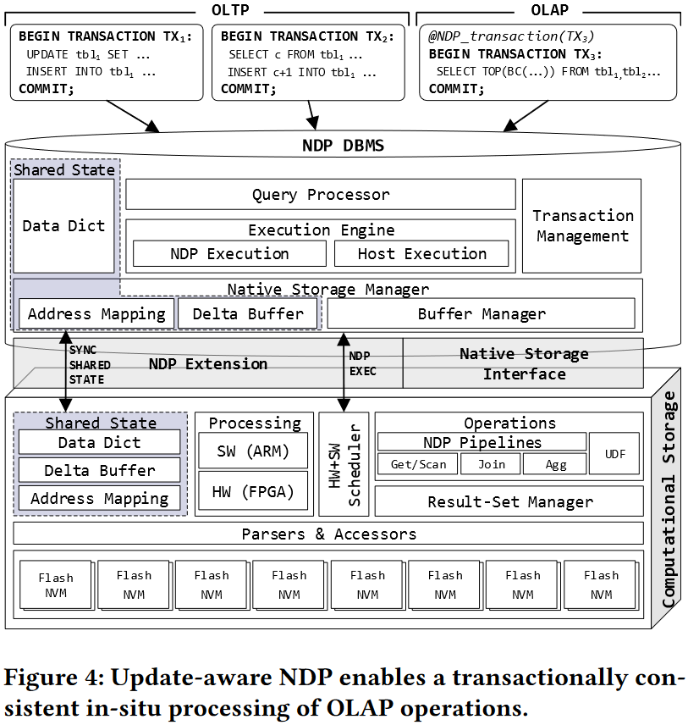
3 Solution
3.1 Overview of the components of the proposed architecture

Slide 7
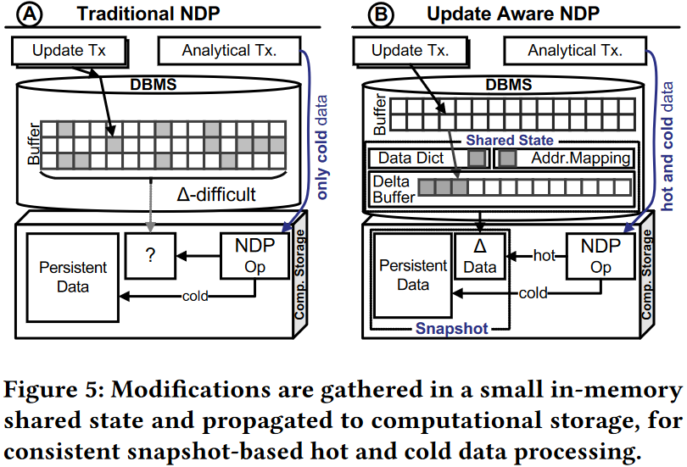
3 Solution
3.2 Shared State accumulate the modifications to all of those structures in an incremental way and place them together in shadow data structures collectively
Delta Buffer
In multi-version DBMS:
accumulate the versions newly created by active transactions while predecessor versions remain in memory
In singel-version DBMS:
contain replacement records

Slide 8
3 Solution
3.2 Shared State accumulate the modifications to all of those structures in an incremental way and place them together in shadow data structures collectively
Shared State Propagation Modes
Flush & Append:
triggered by a flush of the shared state
Pass Along & Cache:
At the time of an NDP invocation

Slide 9
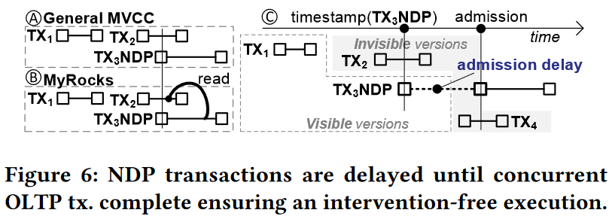
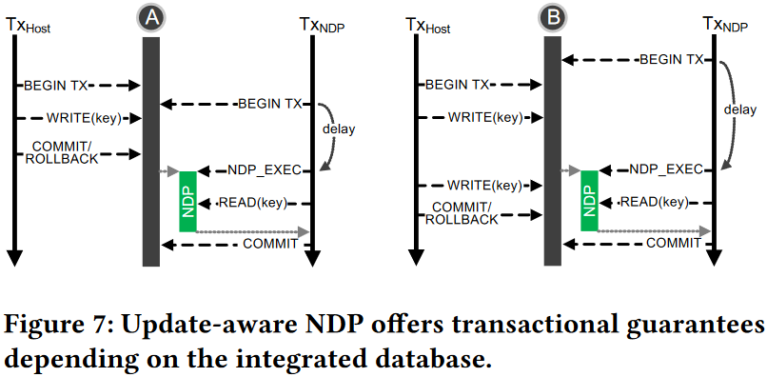
3 Solution
3.3 NDP Transaction Management
Transactional consistency
Issues: MySQL/MyRocks mandates that the visible record is the latest committed ahead of the NDP invocation (snapshot creation), rather than the NDP transaction start.
Admission delay: Whenever such NDP-transaction arrives, it is assigned a transactional timestamp as usual. However, its admission is delayed until after the completion of all transactions that were active when it arrived.
Notes:
右图是什么意思，保证了何种正确性

Slide 10
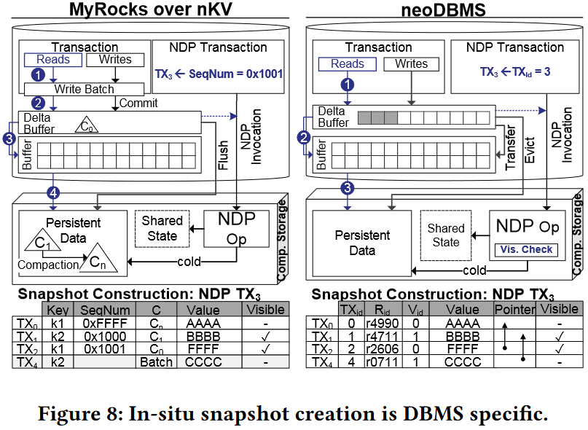
3 Solution
3.3 NDP Transaction Management
In-situ Snapshot Construction
In Copy-on-Write based systems such as nKV：
snapshot is usually identified via a snapshot identifier, e.g. a sequence number
In a multi-version system like neoDBMS, an in-situ visibility checking is performed：
Given the invoking transaction id, the visibility check can traverse the version chain backwards starting from the VID_{MAP} entry point to find the version, visible to the NDP transaction.

Slide 11
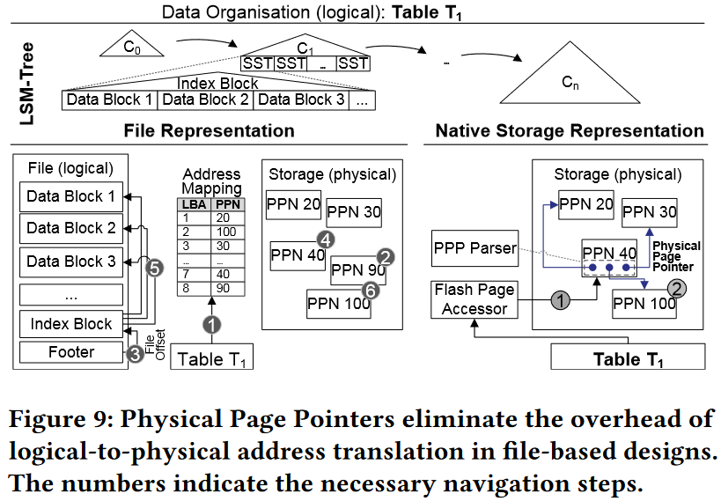
3 Solution
3.4 Parsers and Accessors
Data layout accessors
for in-situ navigation
Format parsers
for data intepretation
Physical page pointers (PPP)
any reference within the persistent dataset is based on a PPP

Slide 12
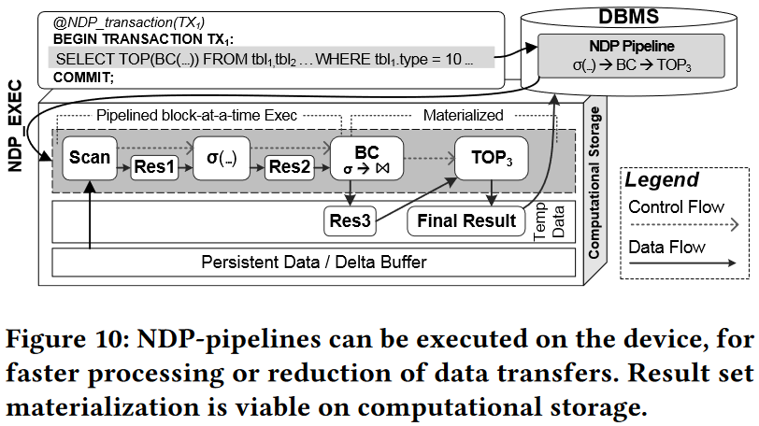
3 Solution
3.5 NDP Pipelines and Result-Set Handling
Local materialization
Allow the creation of complex NDP-pipelines;
In-situ handling of nonsize-reducing operations like joins or grouping;
The reduction of data transfers to host and more efficient DMA handling;

Slide 13
3 Solution
3.6 NDP Interface
Build upon NVMe, yet as a user-space module to avoid high user-/kernel-space switching overhead;
Leverage SPDK;
NDP_EXEC command parameter:
shared state, the operation-specific parameters, metadata and schema information(column families and their respective data formats), number of LSM levels, assignment of SST per level, and many more
3.7 Software and Hardware-based NDP
Foresee a scheduling engine, running in software, that dynamically decides whether to schedule a processing task on a hardware processing element, or to use the software-based alternative ^{( nKV 基于实验获得的经验)}
low-latency、less parallel、faster-scalar-units benefitted operations : point lookup
large scans

Slide 14
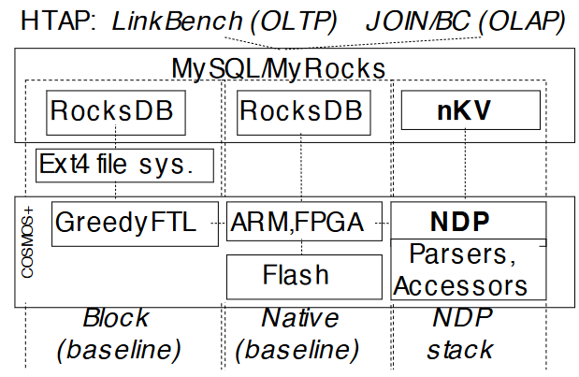
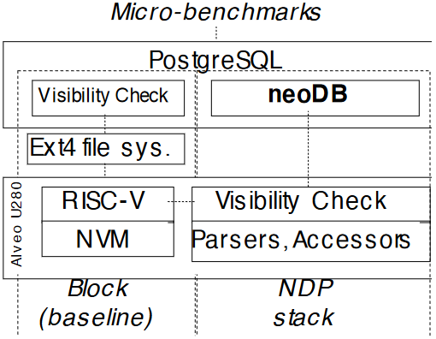
4 Evaluation
1 MyRocks over nKV
Hardware
Host:
Debian 4.9 OS + 3.4 GHz Intel i5 CPU + 4 GB RAM
COSMOS+ board:
PCIe Gen 2.0×8 + Zynq 7045 SoC with an FPGA
Two 667 MHz ARM A9 Cores + An MLC Flash module as SLC
Software
MyRocks (MySQL 5.6) with Repeatable Read
Memory footprint: 7.5% of the dataset size and Mutable memtables: 32 MB
2 neoDBMS
Hardware
Host:
an ARM Neoverse N1 System Development Platform (SDP)
4 2.6 GHz ARM N1-CPUs + 3 GB RAM.
Smart storage:
A Xilinx Alveo U280 FPGA board with 2 GB DDR4 connected via PCIe Gen4×8 serves as enterprise-grade smart storage
Software
PostgreSQL12

Slide 15
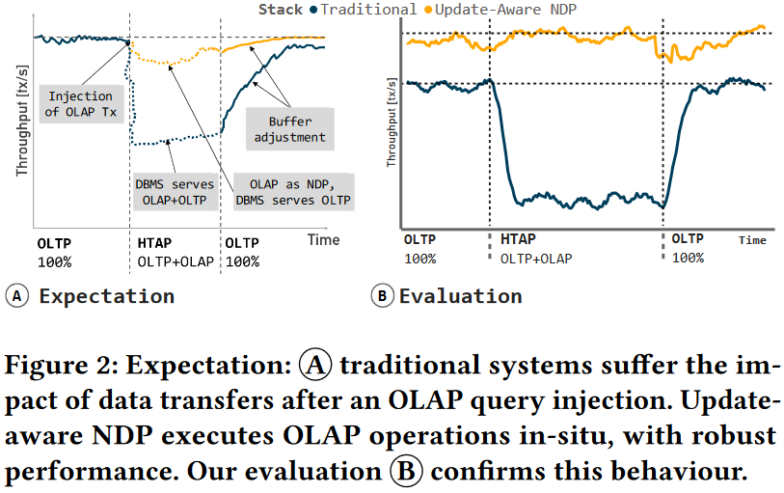
4 Evaluation
3 Workload parameters
OLTP_{SKEW} :
Sets the ratio of hot to cold data accesses
OLAP_{SEL} :
To vary the complexity and runtime, the number of input nodes to BC is limited to a certain threshold
OLAP_{PAUSE} :
It controls the time between two OLAP query injections.

Slide 16
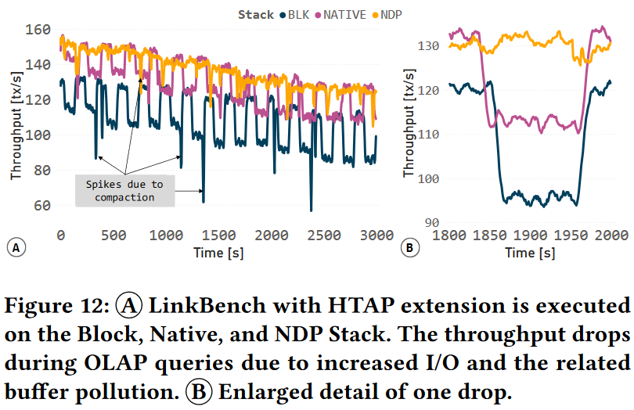
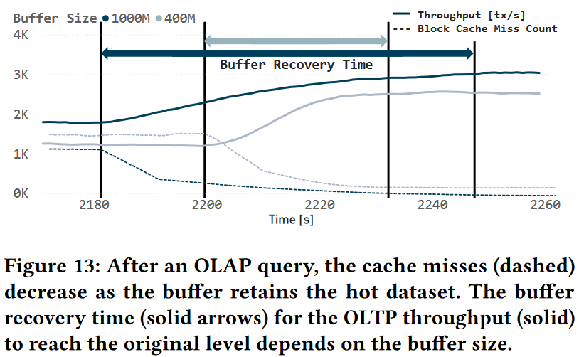
4 Evaluation
Experiment 1: Update-aware NDP enables transactionally consistent NDP executions of OLAP operations in presence of OLTP updates in HTAP systems, without performance drops.

Slide 17
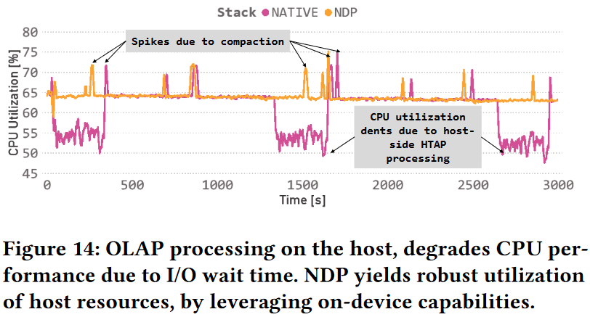
4 Evaluation
Experiment 2: Update-aware NDP is intervention-free, yielding robust and resource-efficient performance.
OLAP_{PAUSE}=1000s

Slide 18
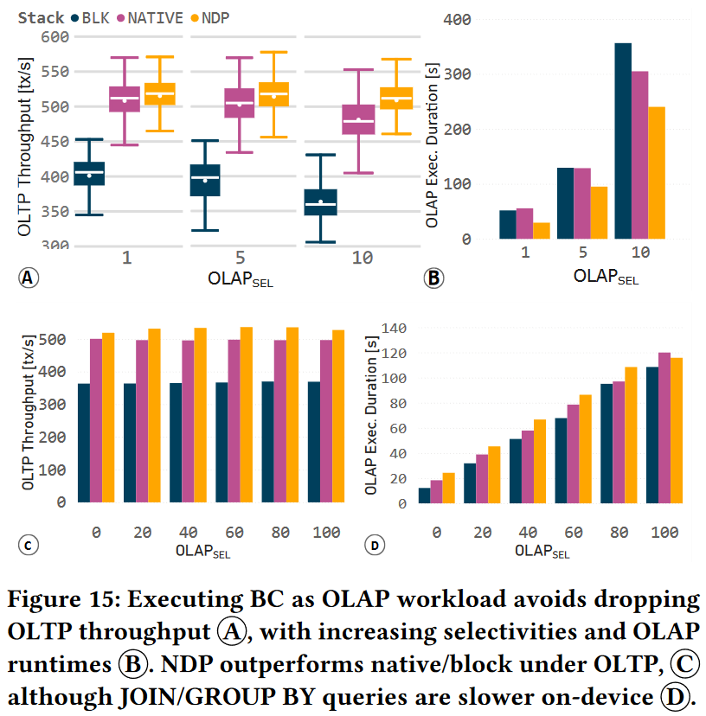
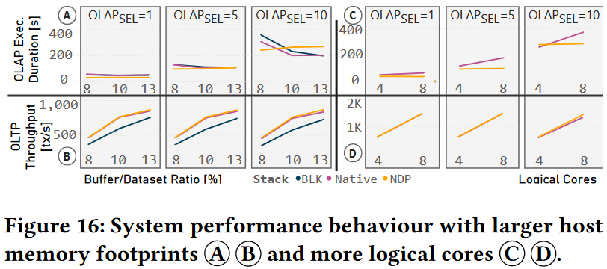
4 Evaluation
Experiment 3: NDP can handle different types of OLAP operations.
Fig15 A B:
HTAP workload, OLTP throughput;
Size-reducing OLAP operations: Selection/BC/TOP
Fig15 D:
Non size-reducing operations: JOIN/GROUP BY/AGGREGATION
NDP OLAP becomes computebound due to the slow on-device ARMs.
Fig15 C ?
Notes:
Fig16 host资源对性能的影响。
AB数据量越大，OLAP持续时间越长；Buffer越大，性能越好，但是有个疑问，B的1 2，第一个应该比第二个低，因为都没有CSD且Native在IO上做了优化；
CD区分了host cpu core对性能的影响，更多的core提升了OLTP的性能，但是增加了buffer争用，导致buffer pollution从而增加了OLAP的查询时长，NDP不存在这个情况

Slide 19
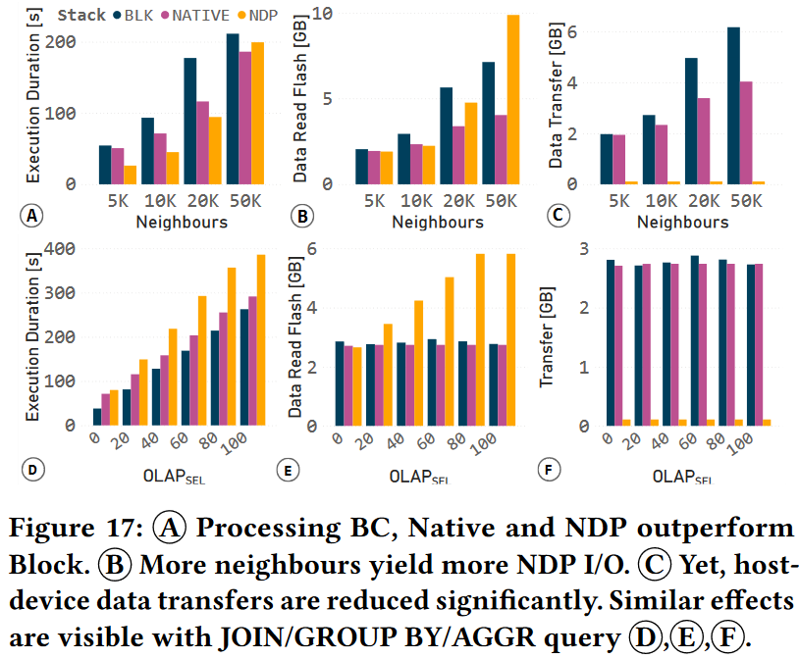
4 Evaluation
Experiment 4: Update-aware NDP reduces data transfers.
Notes:
增加BC处理的neighbours数量（1）ABC说明native 始终优于BLK，NDP在数据量较少时性能较BLK和Native都更优，但是随着数据量增加，执行时间和Flash数据读取数量都增加，BC算法需要很多内存，所以CSD设备的内存容量限制变成了瓶颈，buffer misses变多，flash读取更多了。但是总的来说设备端到主机端的总的数据量搬运还是减少很多。（2）DEF是OLAP的执行时间因为设备端的CPU性能弱，所以时间更长吗？随着数据量的增加，设备内的Flash读区变多，总的数据搬移量变少了。
疑问，用户不是更在意read-only OLAP的时间吗？

Slide 20
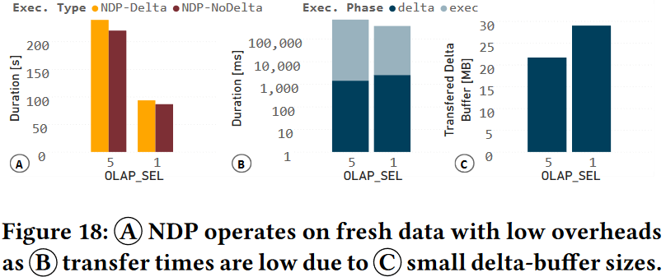
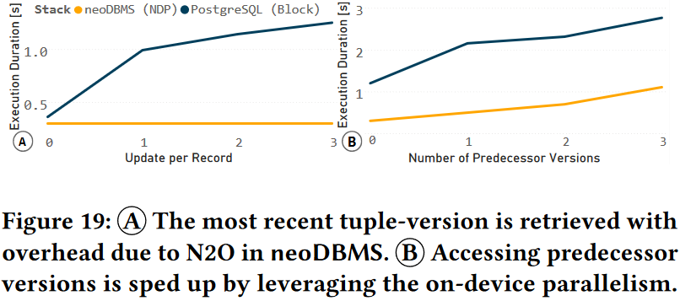
4 Evaluation
Experiment 5: Update-aware NDP can operate on fresh data with low overhead
Experiment 6: Computational storage can efficiently return the visible version or the transactionally consistent snapshot by means of NDP.
Notes:
5 shared state的大小由并行的OLTP更新决定，OLAPsel越小OLAP执行时间越短，有更多的OLTP引发更多的update操作所以share state更大。
6 micro-benchmark on top of TPC-C OrderLine table in the DB stack，

Slide 21
没有谈到涉及写操作的OLAP怎么处理
计算存储设备中的HW+SW Sheduler粒度很大
Notes:
5 shared state的大小由并行的OLTP更新决定，OLAPsel越小OLAP执行时间越短，有更多的OLTP引发更多的update操作所以share state更大。
6 micro-benchmark on top of TPC-C OrderLine table in the DB stack，

Slide 22
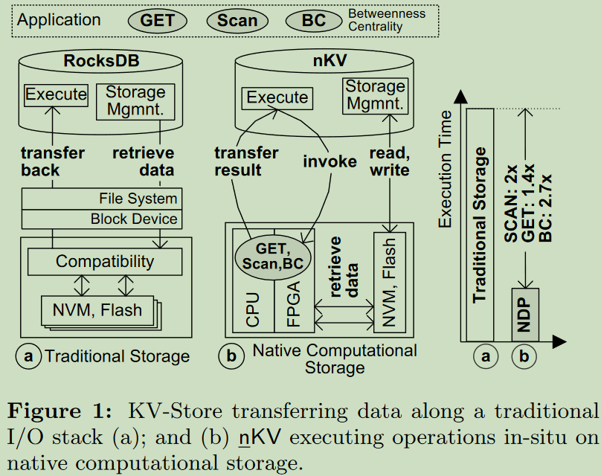
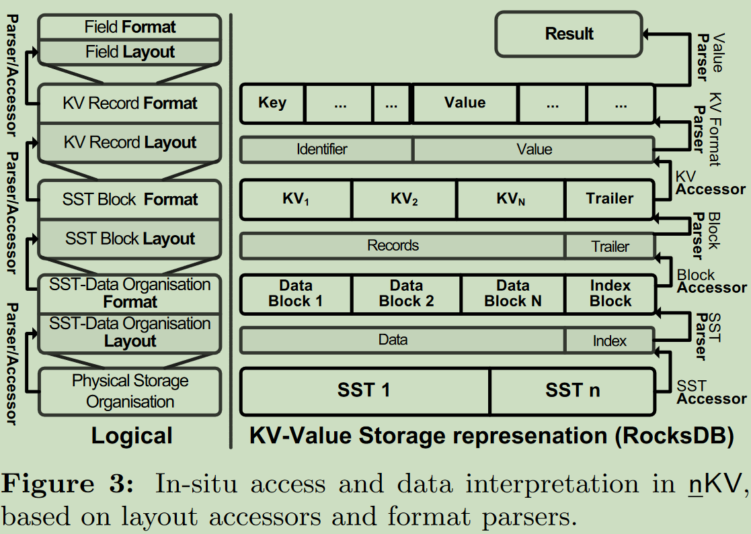
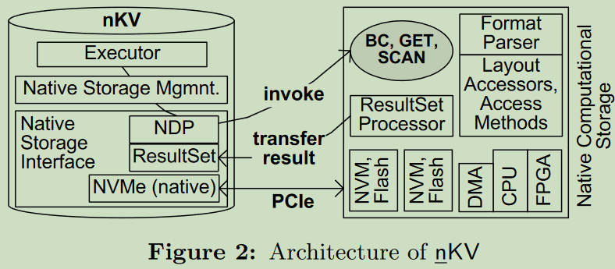
nKV※——Software Architecture
※ Vinçon T, Bernhardt A, Petrov I, et al. nKV: near-data processing with KV-stores on native computational storage[C]//Proceedings of the 16th International Workshop on Data Management on New Hardware. 2020: 1-11.

Slide 23
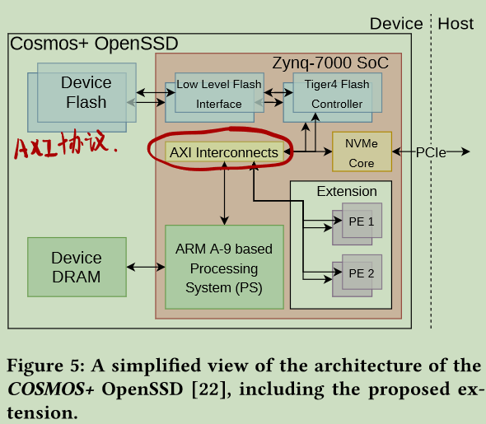
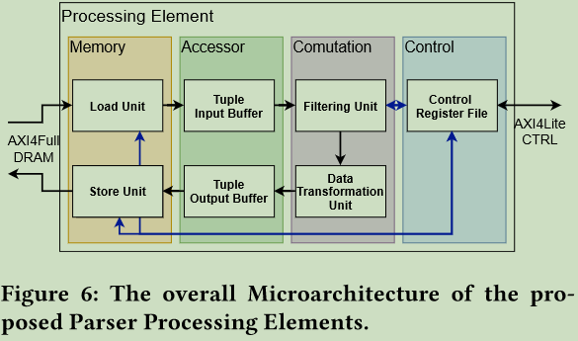
nKV※——Hardware Architecture
Using the baseline architecture (Figure 5), specific processing elements (PEs) are implemented, allowing to move computation from software running on the ARM-cores to the programmable logic of the SoC.
The PEs are written in Chisel3 [3] using a relatively simple architecture that can be subdivided into four distinct domains.
The control-domain consists of a register file, holding a number of control registers, which are accessible using an AXI4-Lite interface.
The memory-domain contains a load and a store unit. These are connected to the PSs DRAM-interface, allowing the PE to access the device DRAM.
The accessor-domain is responsible for converting the different data granularities (64 bit words vs tuples) between the memory and the computational domain.
The computational domain is comprised of two distinct modules. The first one is the filtering unit, which accepts single kv-pairs as input. The last module transforms the data into the required output format
※ Vinçon T, Bernhardt A, Petrov I, et al. nKV: near-data processing with KV-stores on native computational storage[C]//Proceedings of the 16th International Workshop on Data Management on New Hardware. 2020: 1-11.

Slide 24
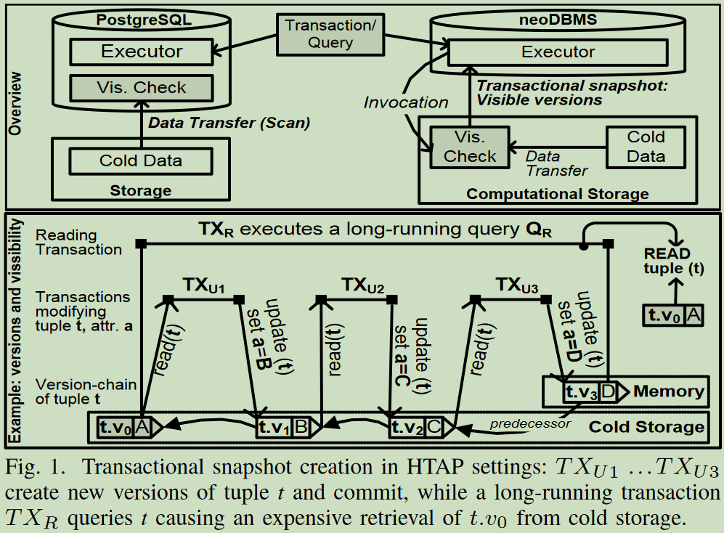
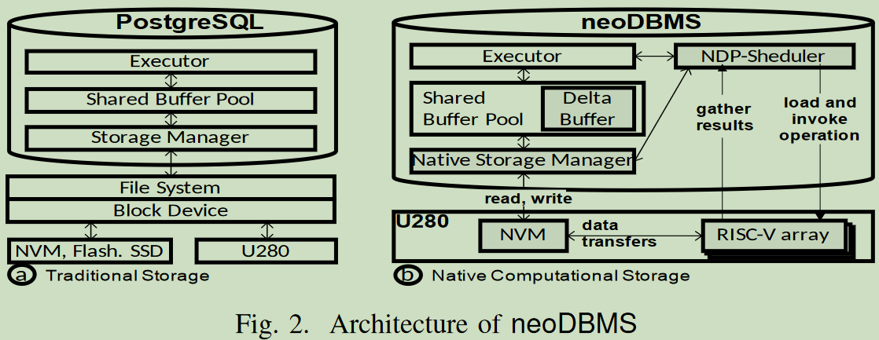
neoDBMS※
neoDBMS结构图
HTAP负载下事务快照示意图
※ Bernhardt A, Tamimi S, Stock F, et al. neodb: In-situ snapshots for multi-version dbms on native computational storage[C]//Proc. ICDE. 2022.

Slide 25
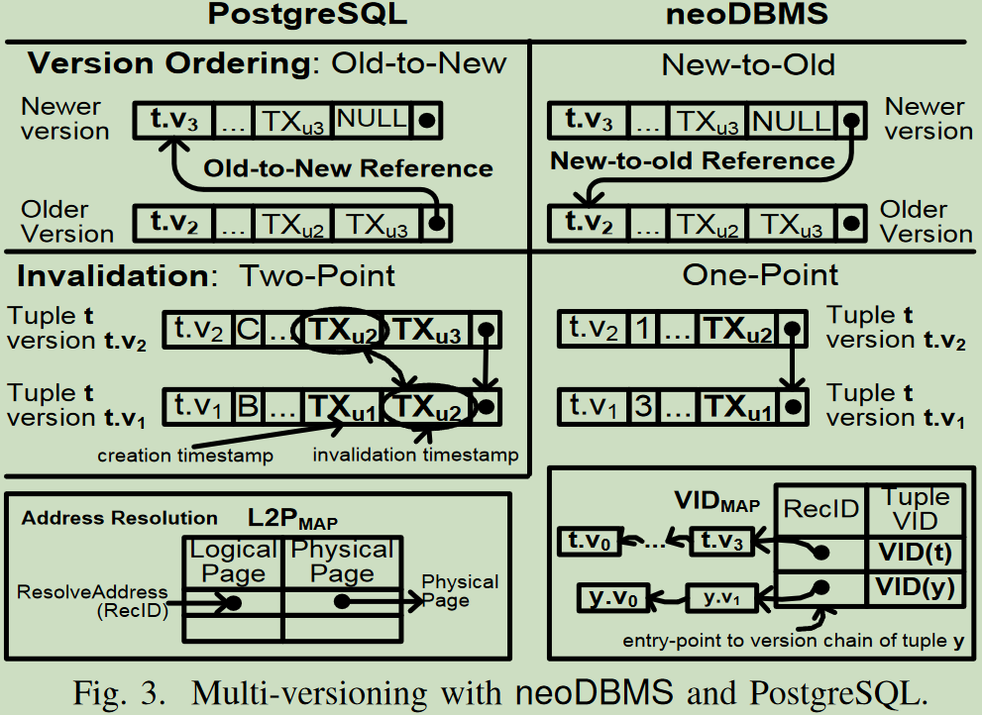
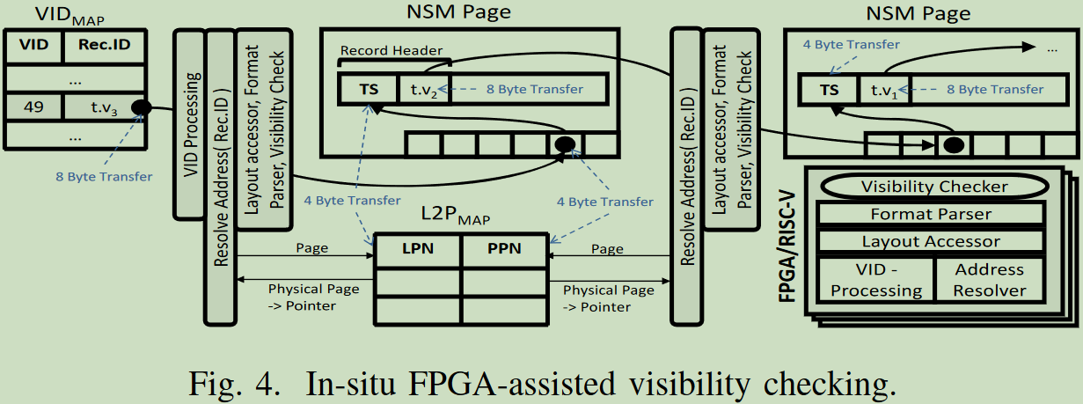
neoDBMS※
版本可见性检查
多版本示意图
※ Bernhardt A, Tamimi S, Stock F, et al. neodb: In-situ snapshots for multi-version dbms on native computational storage[C]//Proc. ICDE. 2022.

